Slide 1

SECURE IMAGE STEGANOGRAPHY SCHEME FOR INFORMATION HIDING MINOR PROJECT I
Submitted By:
Abhi Rustagi (9916103144)
Bhoomika Gupta (9916103121)
Srajan Ahuja (9916103111)
Vansh Jain (9916103191)
Under the supervision of:
Dr. Gyan Singh Yadav

Slide 2
PROBLEM STATEMENT
A new technique for secure image transmission is proposed, which transforms a secret image into a meaningful mosaic image with the same size and looking like a preselected target image. The transformation process is controlled by a secret key, and only with the key can a person recover the secret image nearly losslessly from the mosaic image.

Slide 3
STATE OF THE ART
This project allows a secure way of transmitting information in the form of images. It ensures safety with the help of a key.
Basic application of the project can be used in transmission of various types of media such as video files, audio files etc. This would not restrict transmission just to images. Along with that larger amount of information can be transmitted.

Slide 4
LIMITATIONS
The image becomes blocky after magnification.
Some loss is incurred in the recovered secret image, or more specifically, in the color transformation process.
The number of required bits embedded for recovering the secret image will be increased when the tile image becomes smaller.
Size of the secret image must be comparable to size of the target image.

Slide 5
OBJECTIVE
The aim of this project is to understand and increase the efficiency of a new secure image transmission technique in which automatic transformation of a given large-volume secret image into a so-called secret-fragment-visible mosaic image of the same size is done. In addition to this, the mosaic image creation is not very accurate and through this project we are trying to improve the accuracy of mosaic image creation and this will also help in recovery of our secret as well as target image.
WORK DISTRIBUTION
Initially we discussed various topics and their scopes. Next, different research papers were referred and information on the topic was collected. All the team members helped each other to resolve conflicts in the project and achieve better final solutions.

Slide 6
PROPOSED DESIGN
The proposed method includes two main phases:
Mosaic image creation: The phase includes four stages
fitting the tile images of the secret image into the target blocks of a target image.
transforming the color characteristic of each tile image in the secret image to become that of the corresponding target block in the target image.
rotating each tile image into a direction with the minimum RMSE value wrt its corresponding target block.
embedding relevant information into the created mosaic.
2. Secret image recovery: The phase includes two stages:
extracting the embedded information for secret image recovery from the mosaic image.
recovering the secret image using the extracted information.

Slide 7
PROPOSED DESIGN

Slide 8
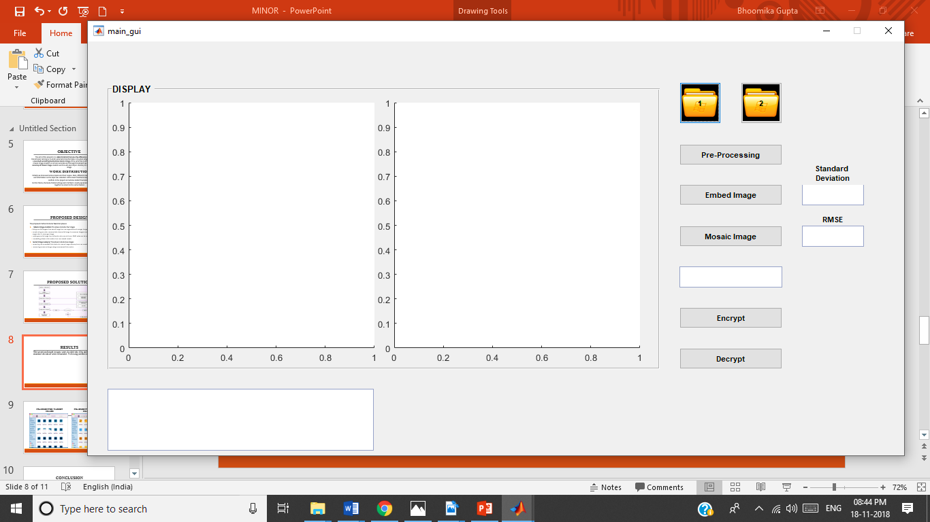
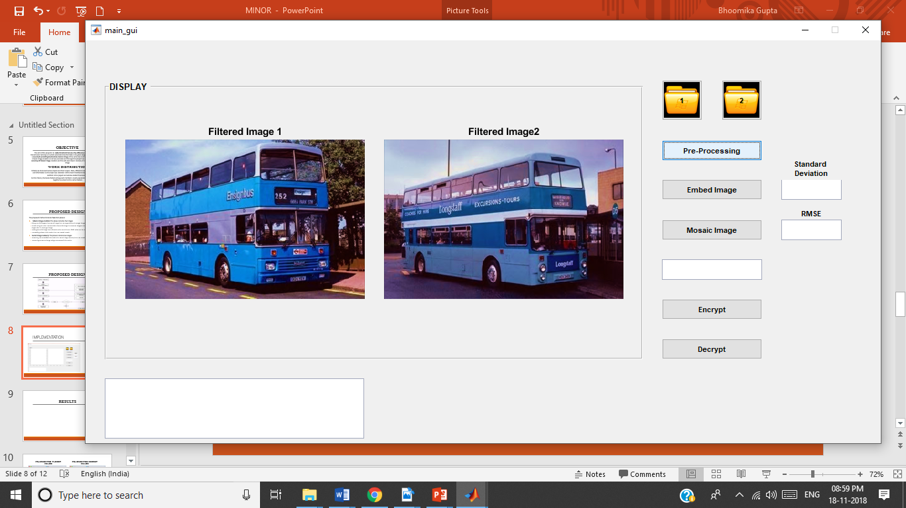
IMPLEMENTATION: ENCRYPTION

Slide 9
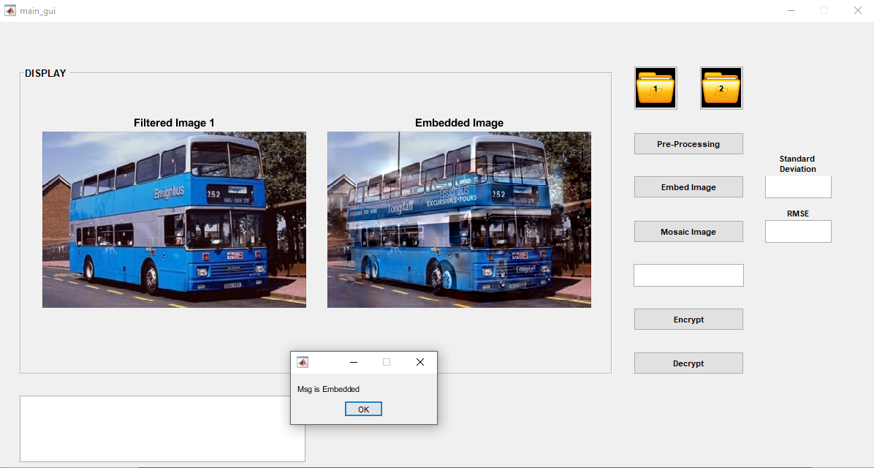

Slide 10
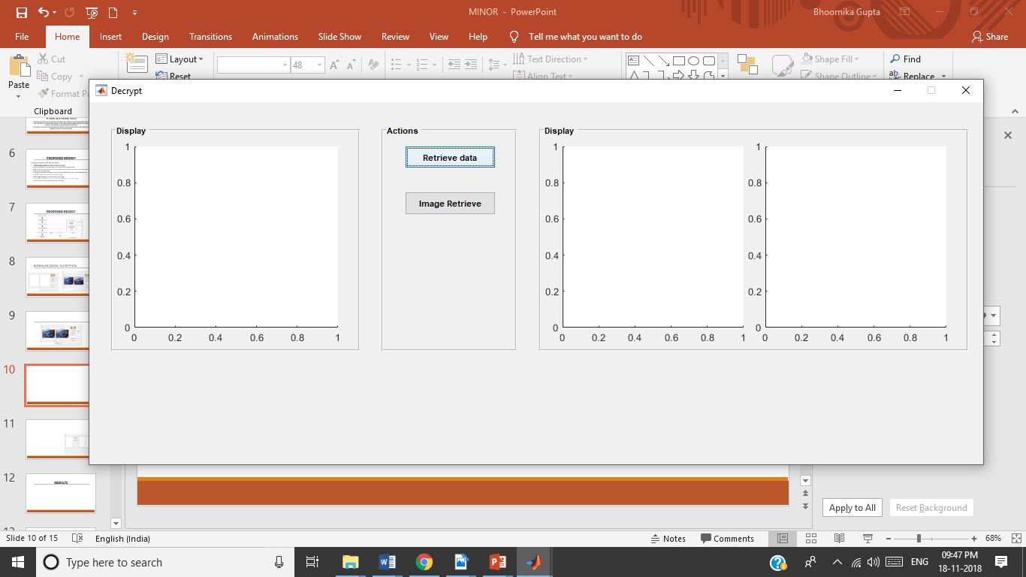
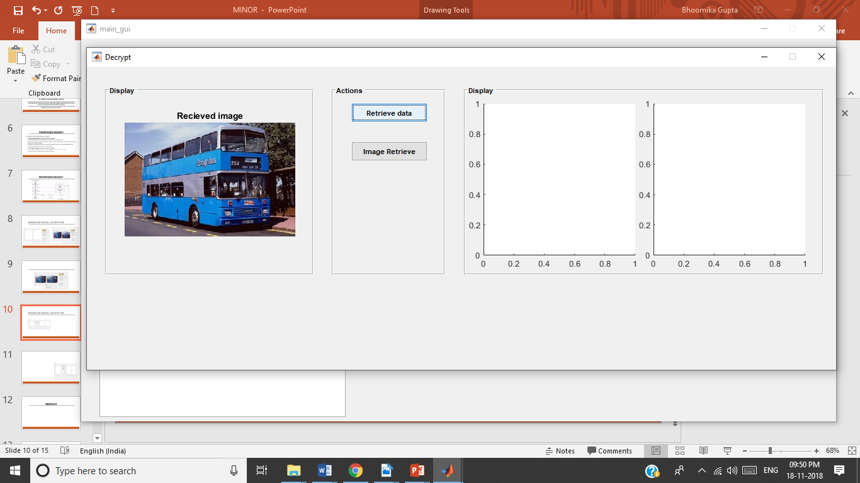
IMPLEMENTATION: DECRYPTION

Slide 11
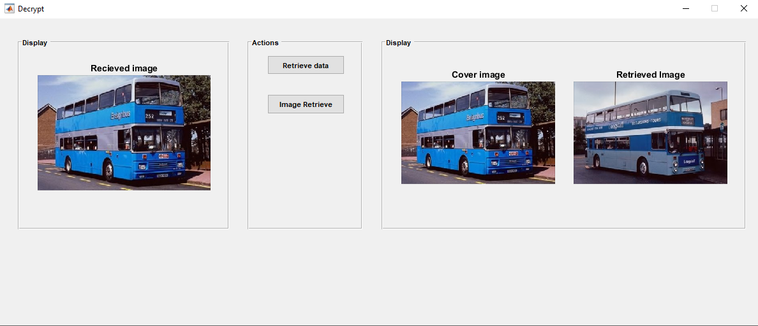

Slide 12
RESULTS
The project was tested on various image samples and the following results were obtained:
Preprocessing removes noise from both the target image and the secret image.
Embedding embeds the secret image into the target image.
Mosaic Image creation creates the final mosaic image.
Even though the images are resized, if there is a significant difference in there size and dimensions the image loses its properties while preprocessing and hence mosaic image creation is not possible.
According to the research proposed by Lee and Tsai, any arbitrary image can be chosen as the target image but the results have shown that the color characteristics of the secret and the target image must be similar to get more secure mosaic image.

Slide 13
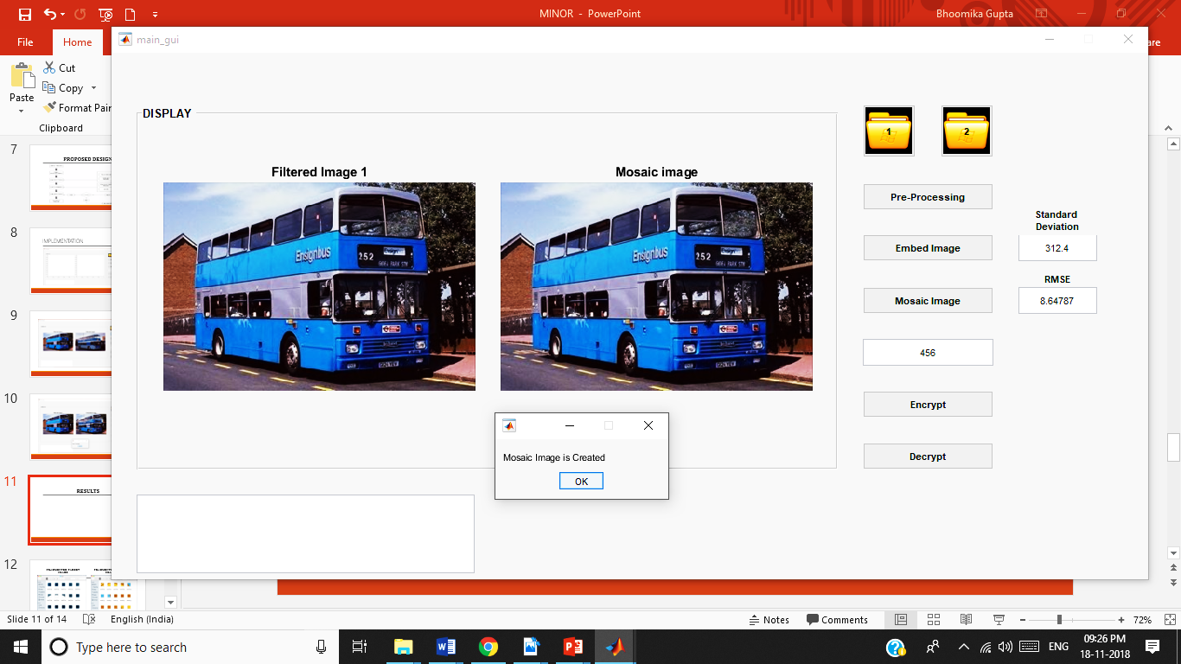
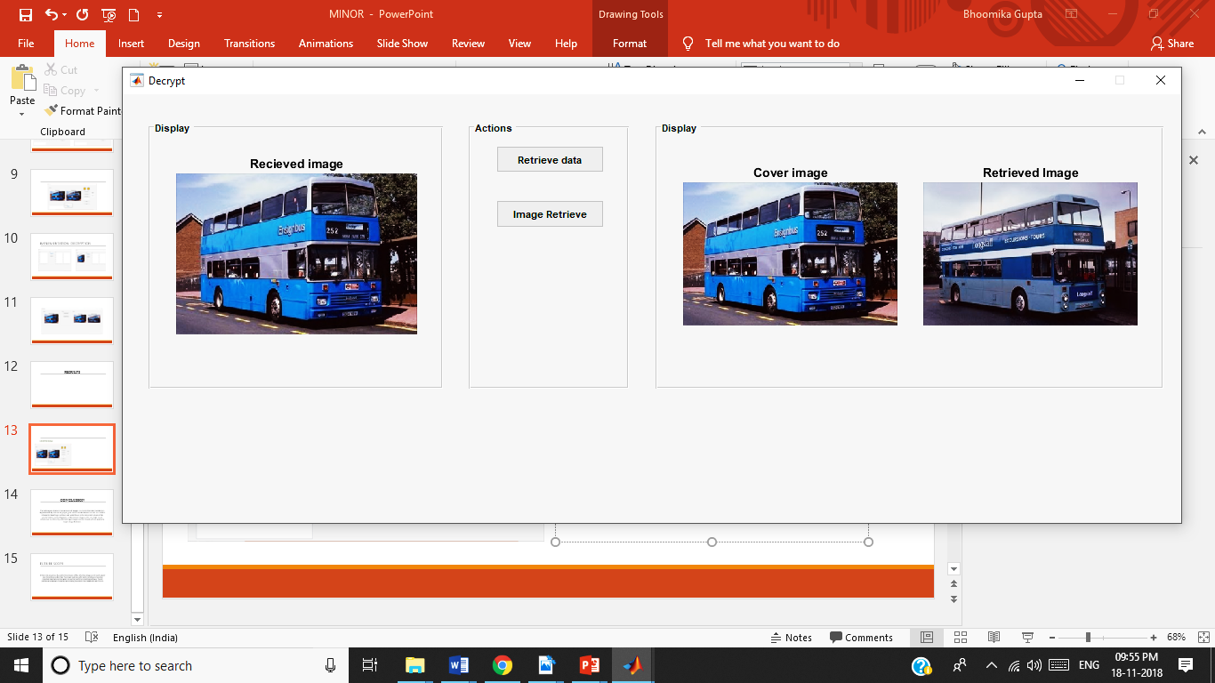
Encrypted image
DECRYPTED IMAGE

Slide 14
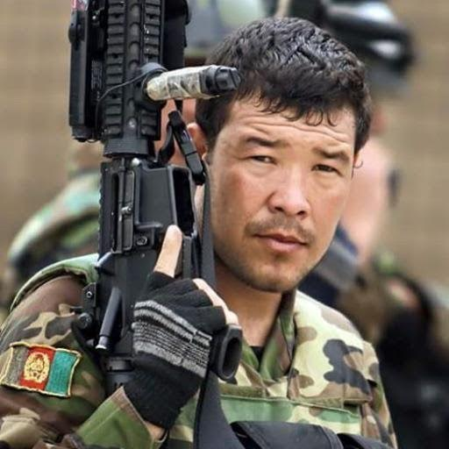


Embedding secret image into target image of Different Dimensions.
Target Image
Secret Image

Slide 15
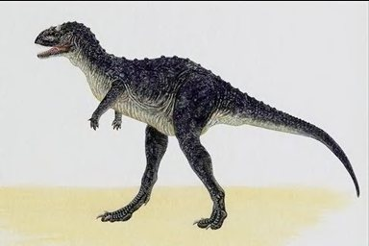


Embedding secret image into target image with significantly different color characteristics
Secret Image
Target Image
Mosaic Image
The mosaic image so created shows the traces of the secret image which can arouse others suspicion over the image.

Slide 16
CONCLUSION
The technique of secure transmission of images via reversible color transform is implemented. By the use of proper pixel color transformations as well as a skillful scheme for handling overflows and underflows in the converted values of the pixels’ colors, secret-fragment-visible mosaic images with very high visual similarities to arbitrarily-selected target images can be created with no need of a target image database.

Slide 17
FUTURE SCOPE
In future the project can be used for transmission of files other than images and it could support color transmissions other RGB. The project could be useful tool for sending and receiving important data that could be hacked or used for harmful and unethical purposes. The key provides an extra layer of security hence making the system more reliable and safer for use.

